Slide 1
ARTIFICIAL INTELLIGENCE
Make business decisions easy...

Slide 2
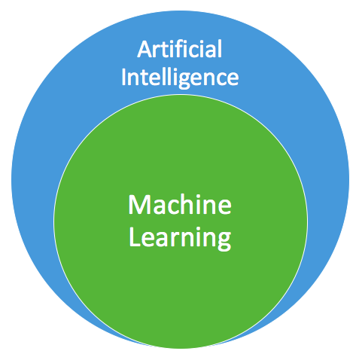
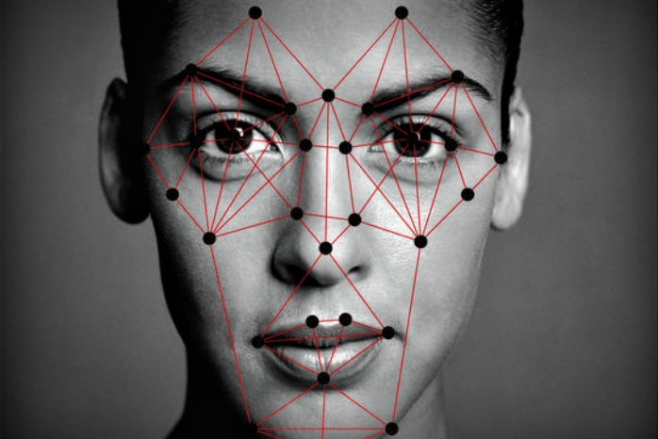

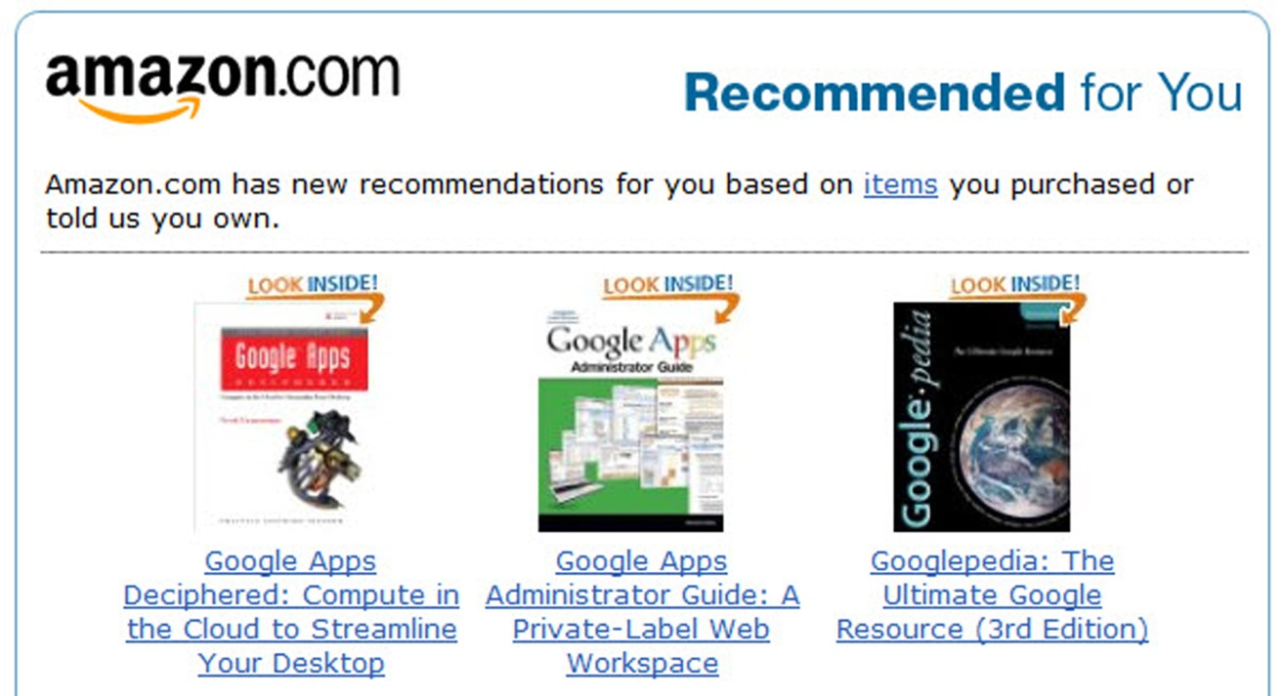
Artificial Intelligence and Machine Learning
Artificial Intelligence (AI): techniques that allow machines to carry out tasks by mimicking human intelligence
Machine Learning: Application of AI that provides machines data and lets them train themselves
Applications
Image Recognition
Natural Language Processing
Recommendations

Slide 3

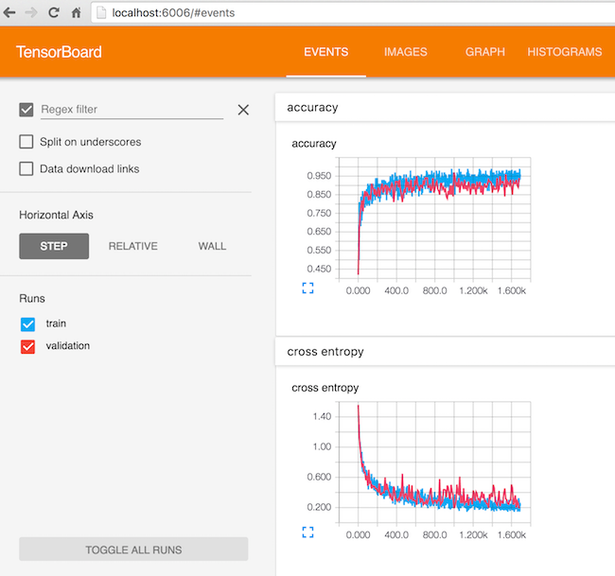
Google TensorFlow
Artificial Intelligence software developed by Google
Designed to build analytical models that detect patterns
Made public in 2015

Slide 4
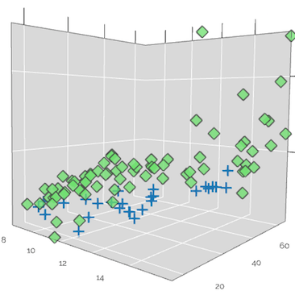

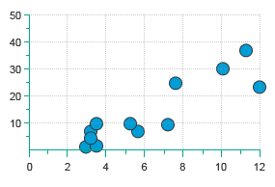
Advantage of Using TensorFlow
TensorFlow is useful for prediction models that involve multiple variables and many data points
2 Variables
3 Variables
4+ Variables

Slide 5

Use Case: Deepening Client Relationships
Which clients are likely to deepen their relationship with Boston Private?

Slide 6
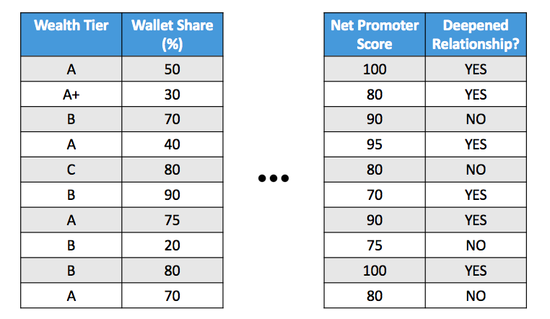
Implementation
Obtain transaction history and Salesforce data
Current Wallet Share
Net Promoter Score
Transaction trends- Balances
Number of accounts over time
No. of Services- Online banking, etc
Did they deepen relationship?

Slide 7
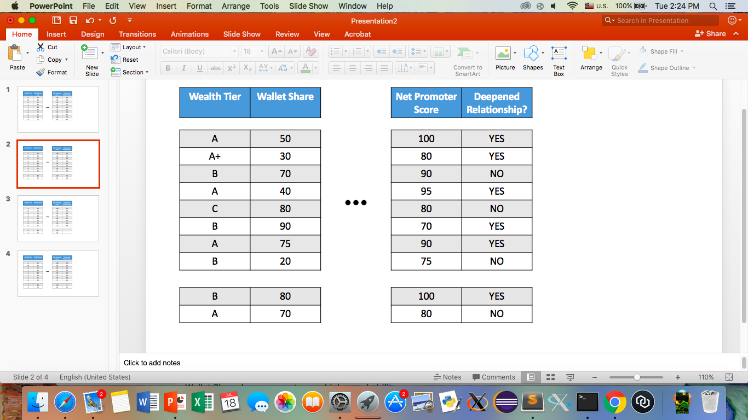
Implementation
Divide data 80/20

Slide 8
Implementation
Train program with 80% of relationships
Based on other fields, is client is likely/unlikely to deepen relationship?
Creates a model that best fits data

Slide 9

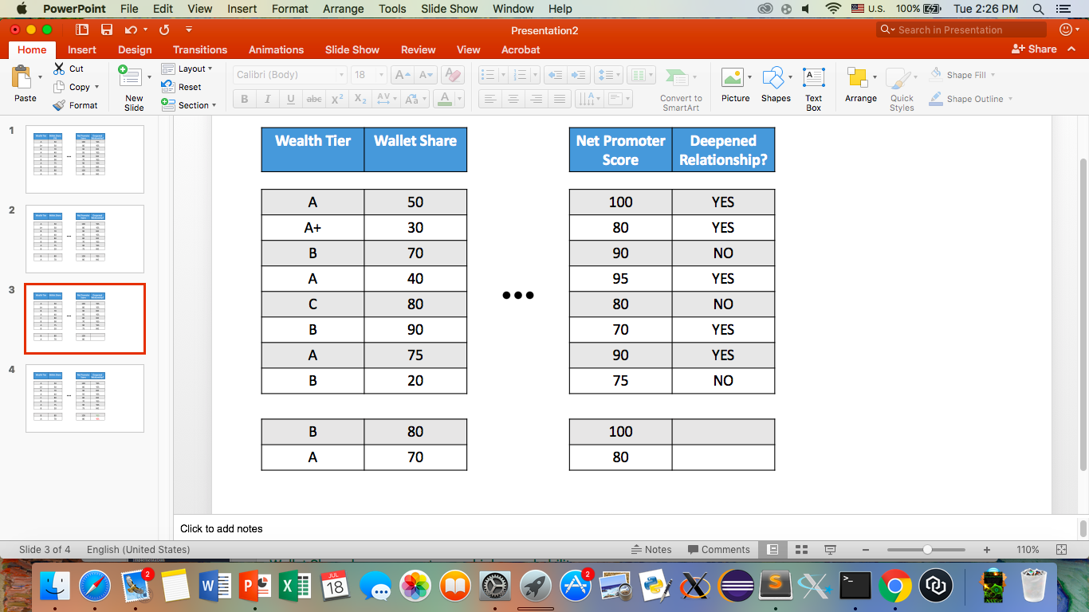
Implementation
Test model
How well does it predict results for the other 20% of relationships?
Actual
Prediction
50% accuracy

Slide 10
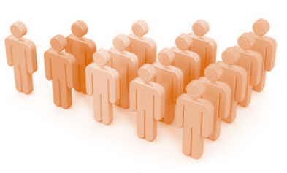
Implementation
Continue to train model with new clients (more data)

Slide 11
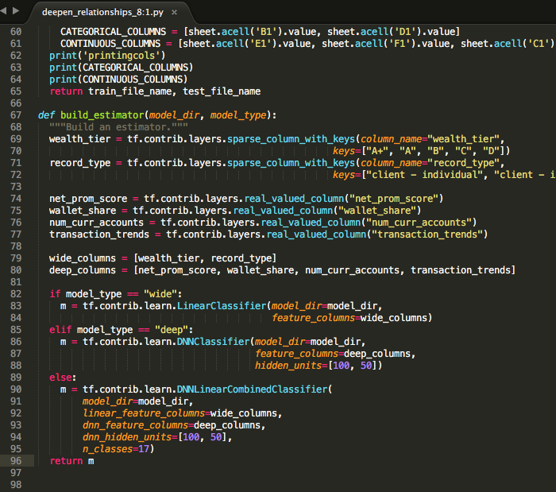
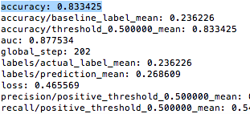
Implementation
Notes:
Left: screenshot of our code…
Screenshot of the accuracy of model…
Currently working on a rather esoteric bug… have contacted Tensorflow professionals for help
But if we get past that we will obtain something like the right screenshot

Slide 12
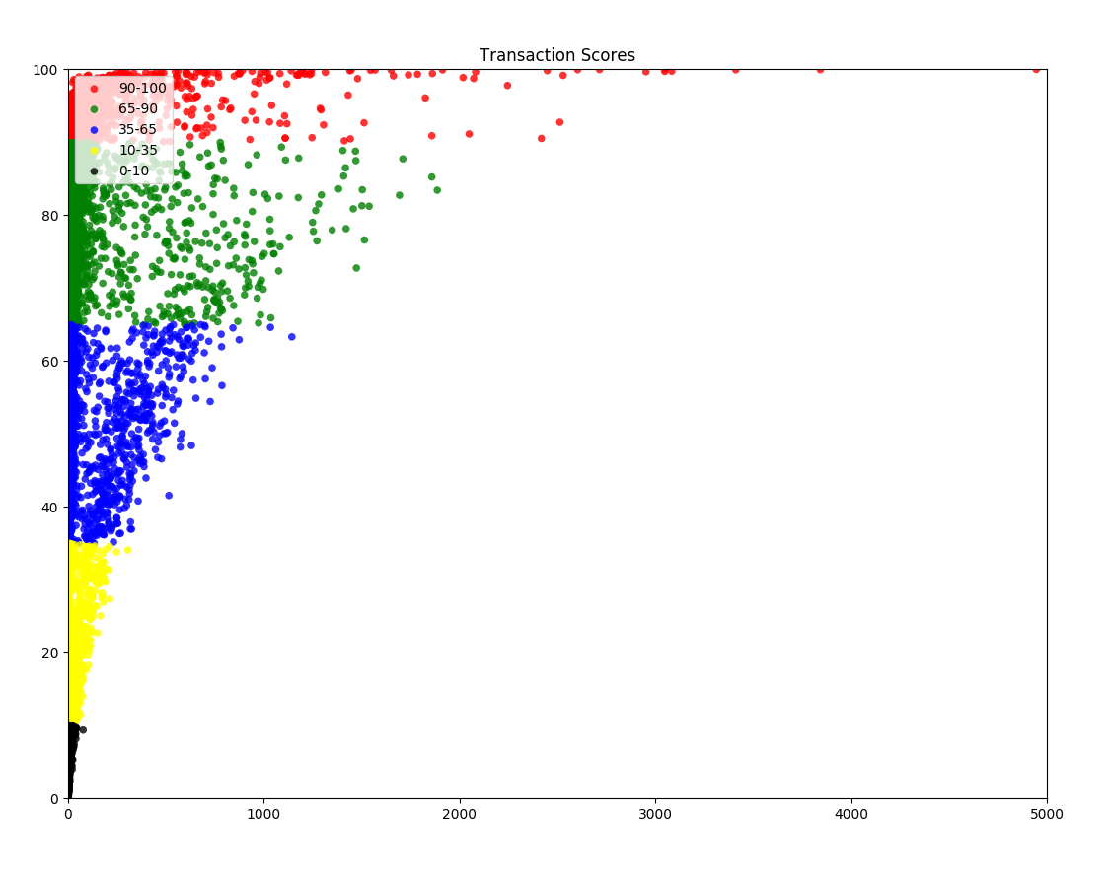

Slide 13
Artificial Intelligence
Data analysis tools can enable Boston Private to deepen client relationships more efficiently

